Slide 1
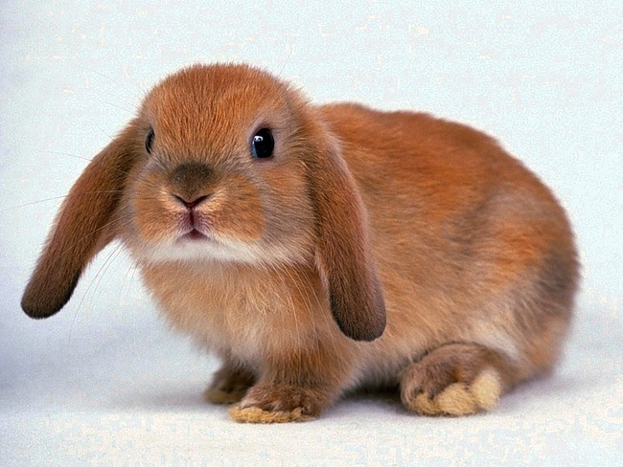
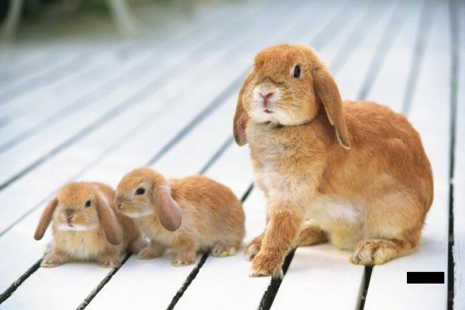
A rabbit
three rabbits

Slide 2
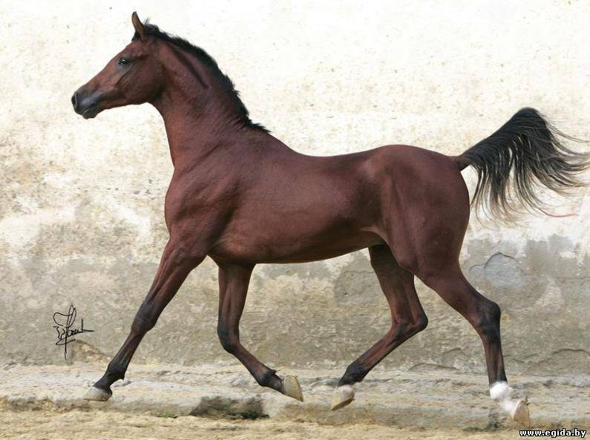
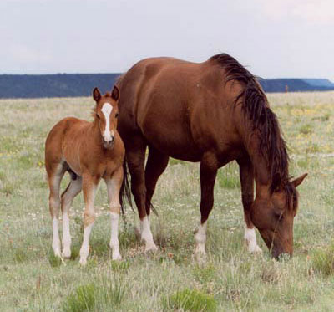
A horse
two horses

Slide 3
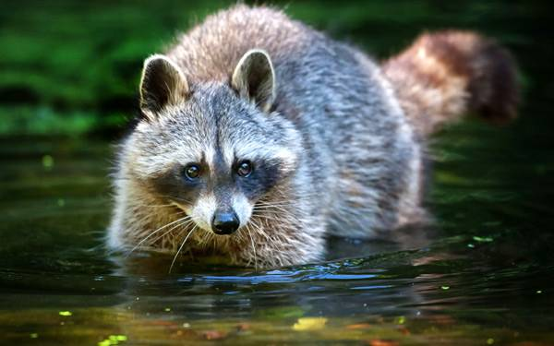
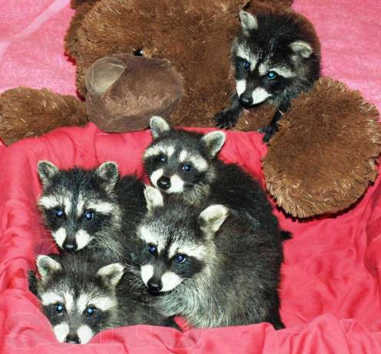
A raccoon
five raccoons

Slide 4
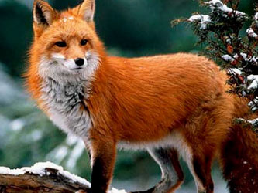
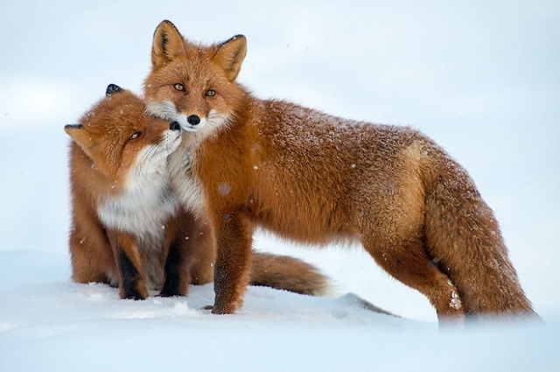
A fox
two foxes

Slide 5
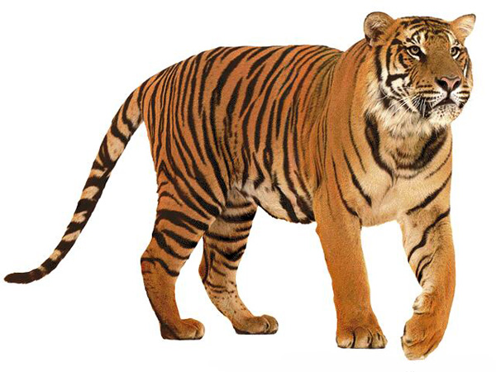
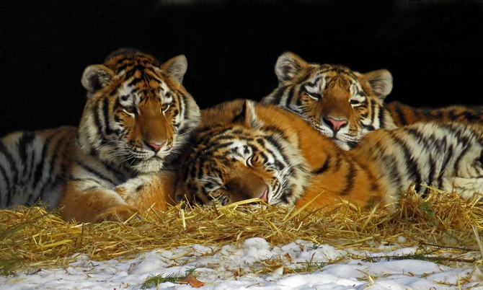
A tiger
three tigers

Slide 6
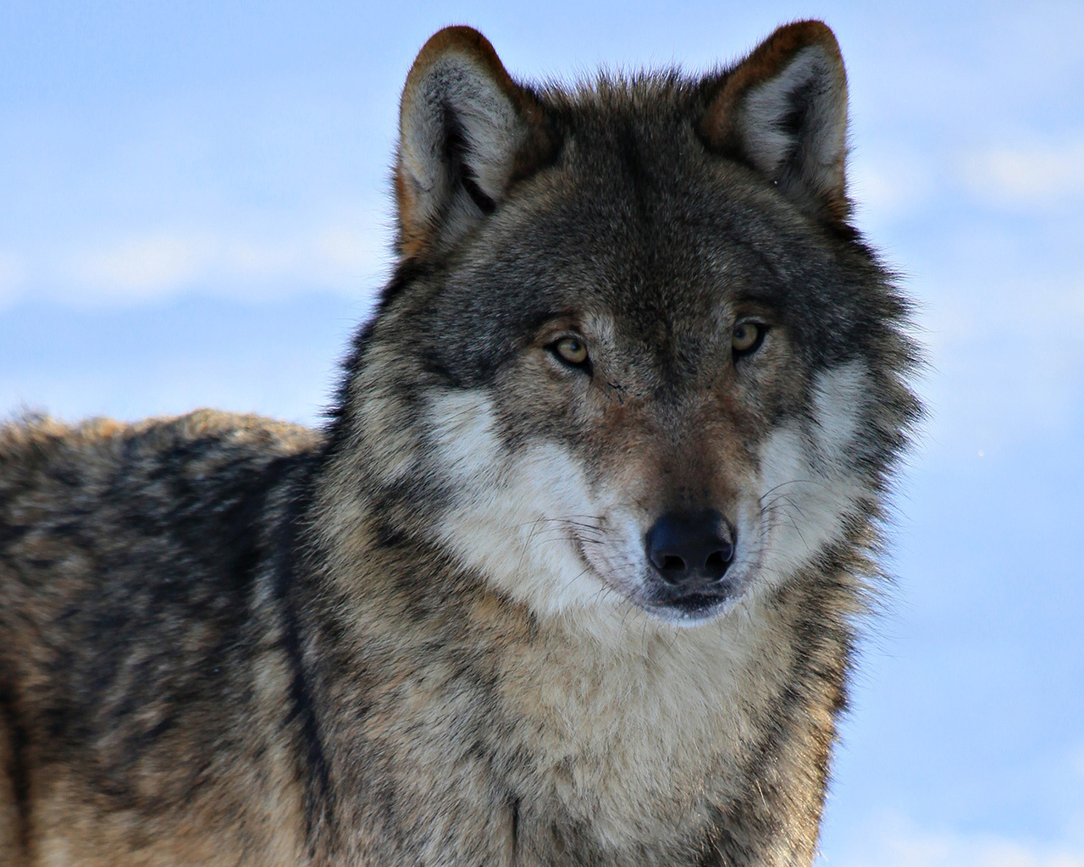
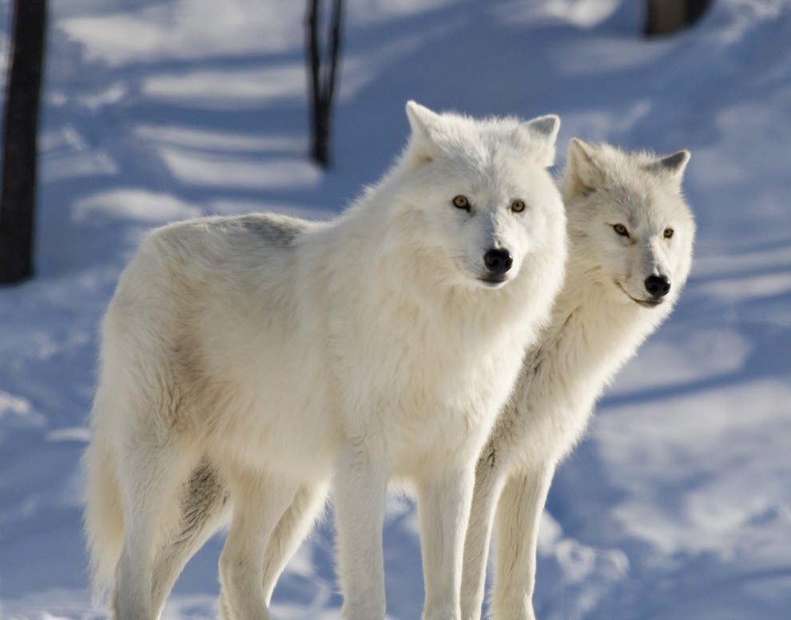
A wolf
two wolves

Slide 7
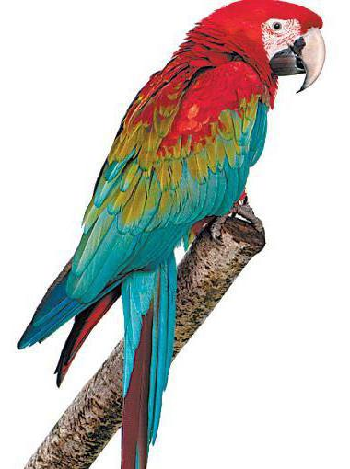
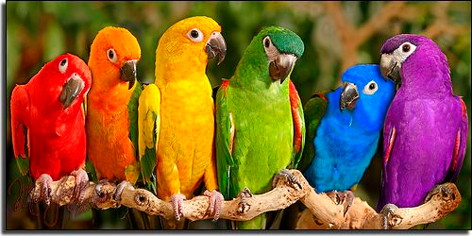
A parrot
six parrots

Slide 8
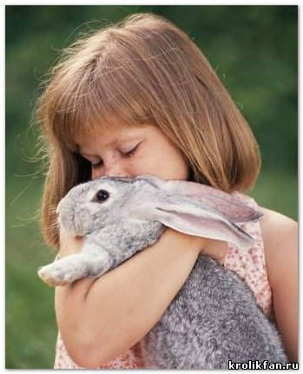
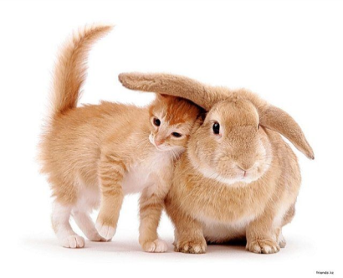
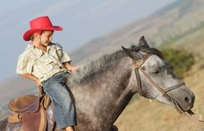
1.I am afraid of tigers.
I like horses.
2. I like rabbits and cats.
I am afraid of wolves and tigers.
Ann
Mike

Slide 9
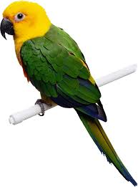
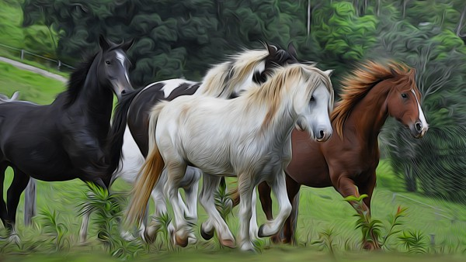
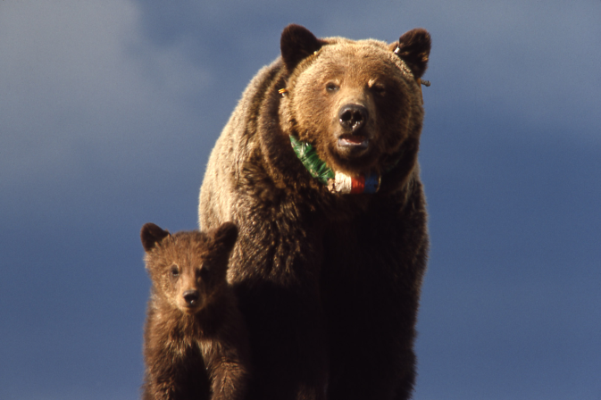
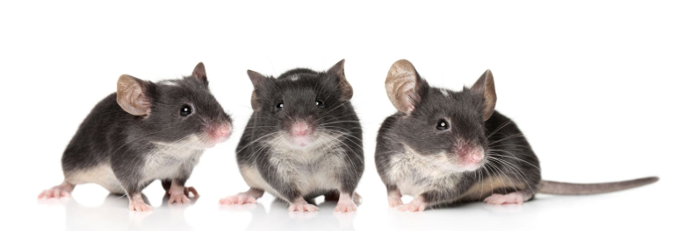
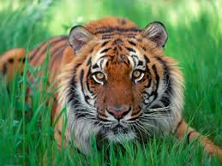
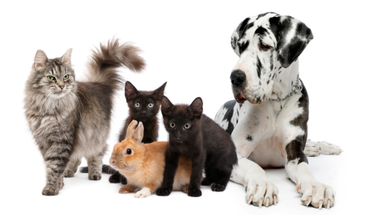
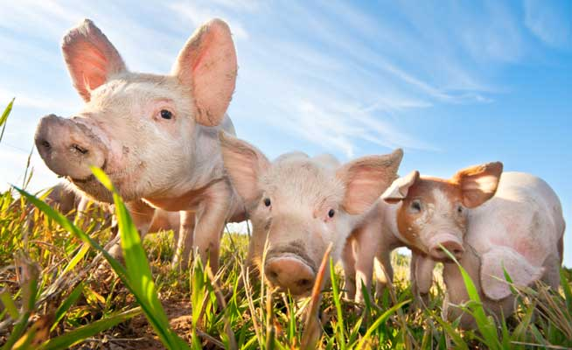
I am afraid of….. I like …….
bears
cats
foxes
mice
rabbits
parrots
raccoons
pigs
wolves
tigers
horses
dogs

Slide 10
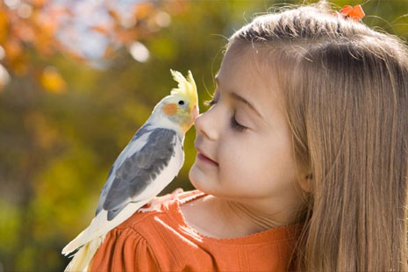
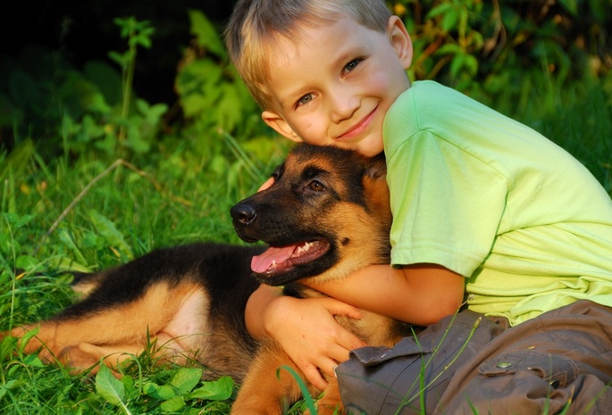
Hi !My name is Will. I am 9. I like animals , too. My favourite animals are dogs. They are friendly and smart. I like playing with my dog Grey!
Hi, I am Kate.I am 10.
I like animals.
My favourite animals are parrots.
They are funny and smart.
I like playing with my parrot Kesha.

Slide 11
Hi, I am…..
I am …9/10/8.
My favourite animals are….
They are …..
I like playing with……
I am afraid of……

